Slide 1



Accessing The Cluster
Germán Bonilla-Rosso
Natasha Glover
SAGE 2022-2023
Faculty of Biology and Medicine
Department of Fundamental Microbiology

Slide 2
Learning objectives
Understand what is a cluster
Load software
into your session
Upload/Download files
to/from your session
Run jobs and interact
With the job manager

Slide 3
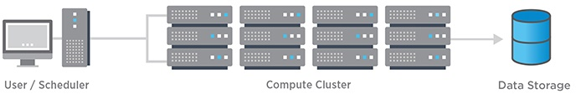
High Performance Computing
An HPC cluster consists of two to thousands of nodes (standalone, virtual or physical computers), connected through fast networks. The nodes in each cluster work in parallel with each other, boosting processing speed to deliver high-performance computing.
https://www.netapp.com/us/info/what-is-high-performance-computing.aspx

Slide 4
Curnagl
The cluster we will use in this course is Curnagl, hosted by the Ci-DCSR at curnagl.dcsr.unil.ch
The cluster has 72 nodes, with 24 CPUs and 512 Gb of memory each
https://www.netapp.com/us/info/what-is-high-performance-computing.aspx

Slide 5
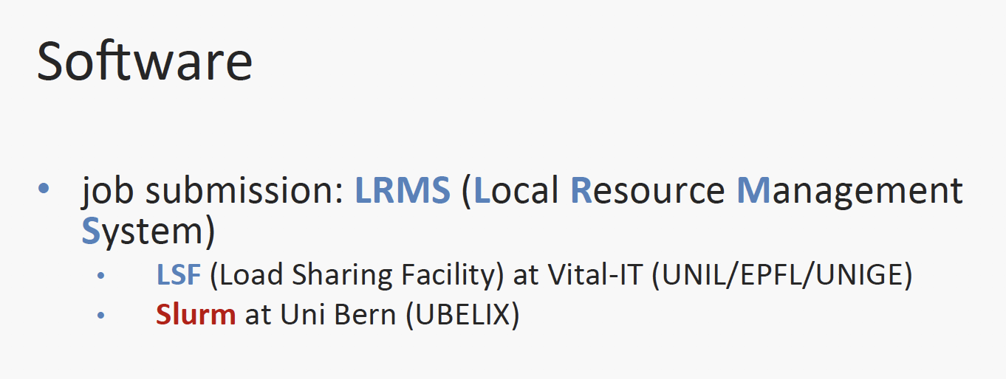
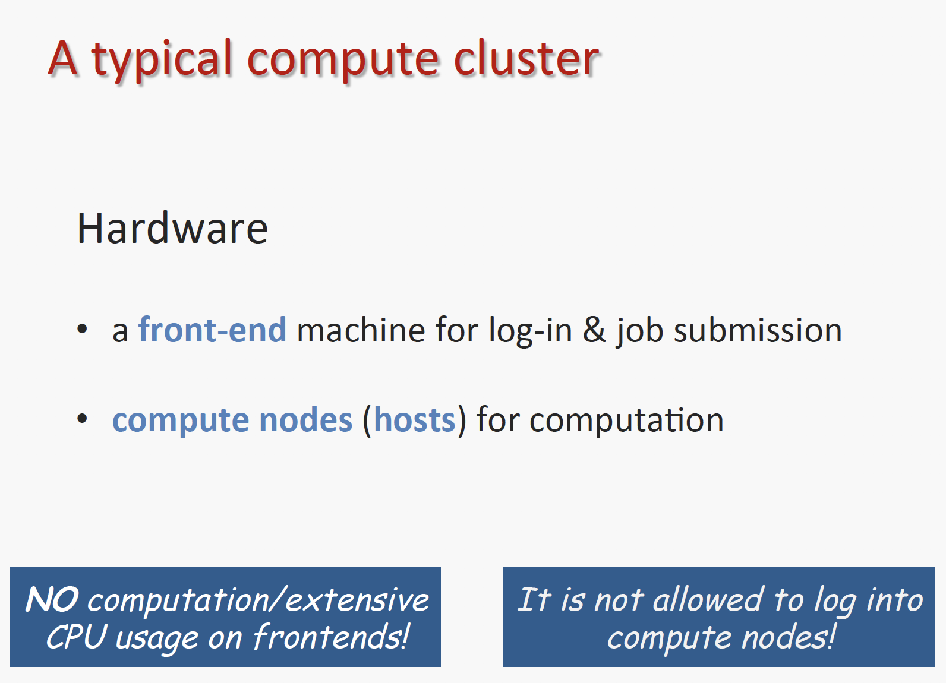
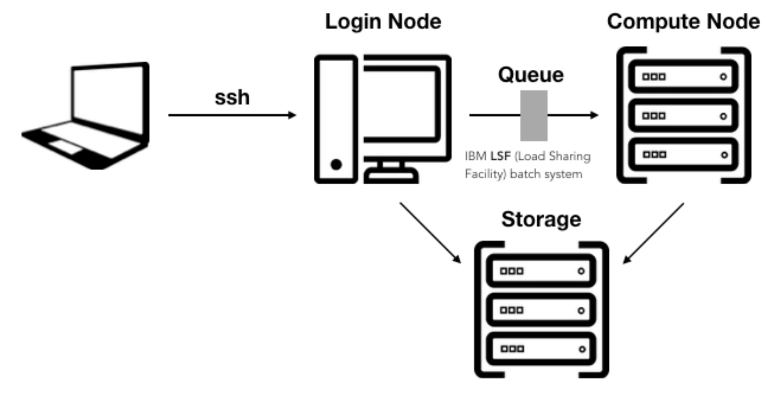
Slurm for Curnagl

Slide 6
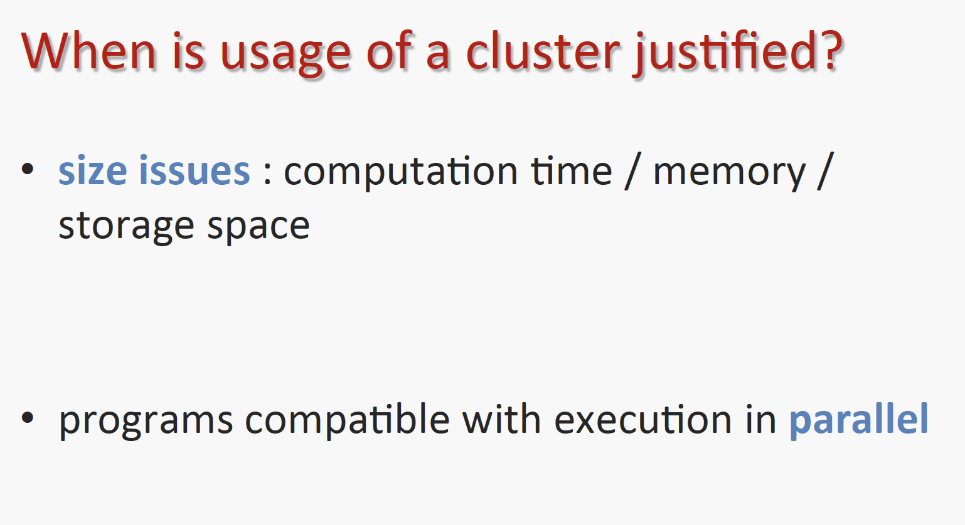
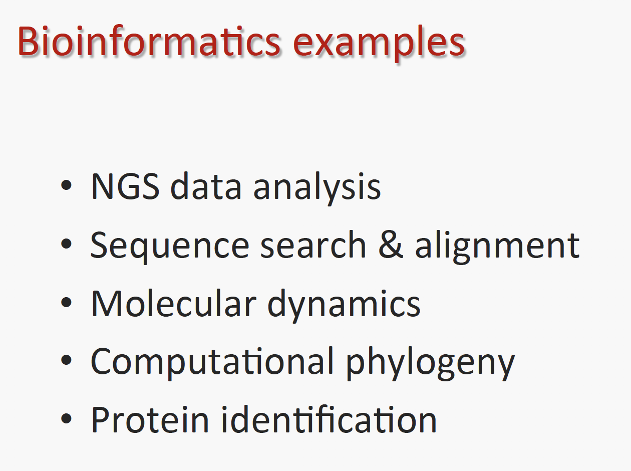

Slide 7
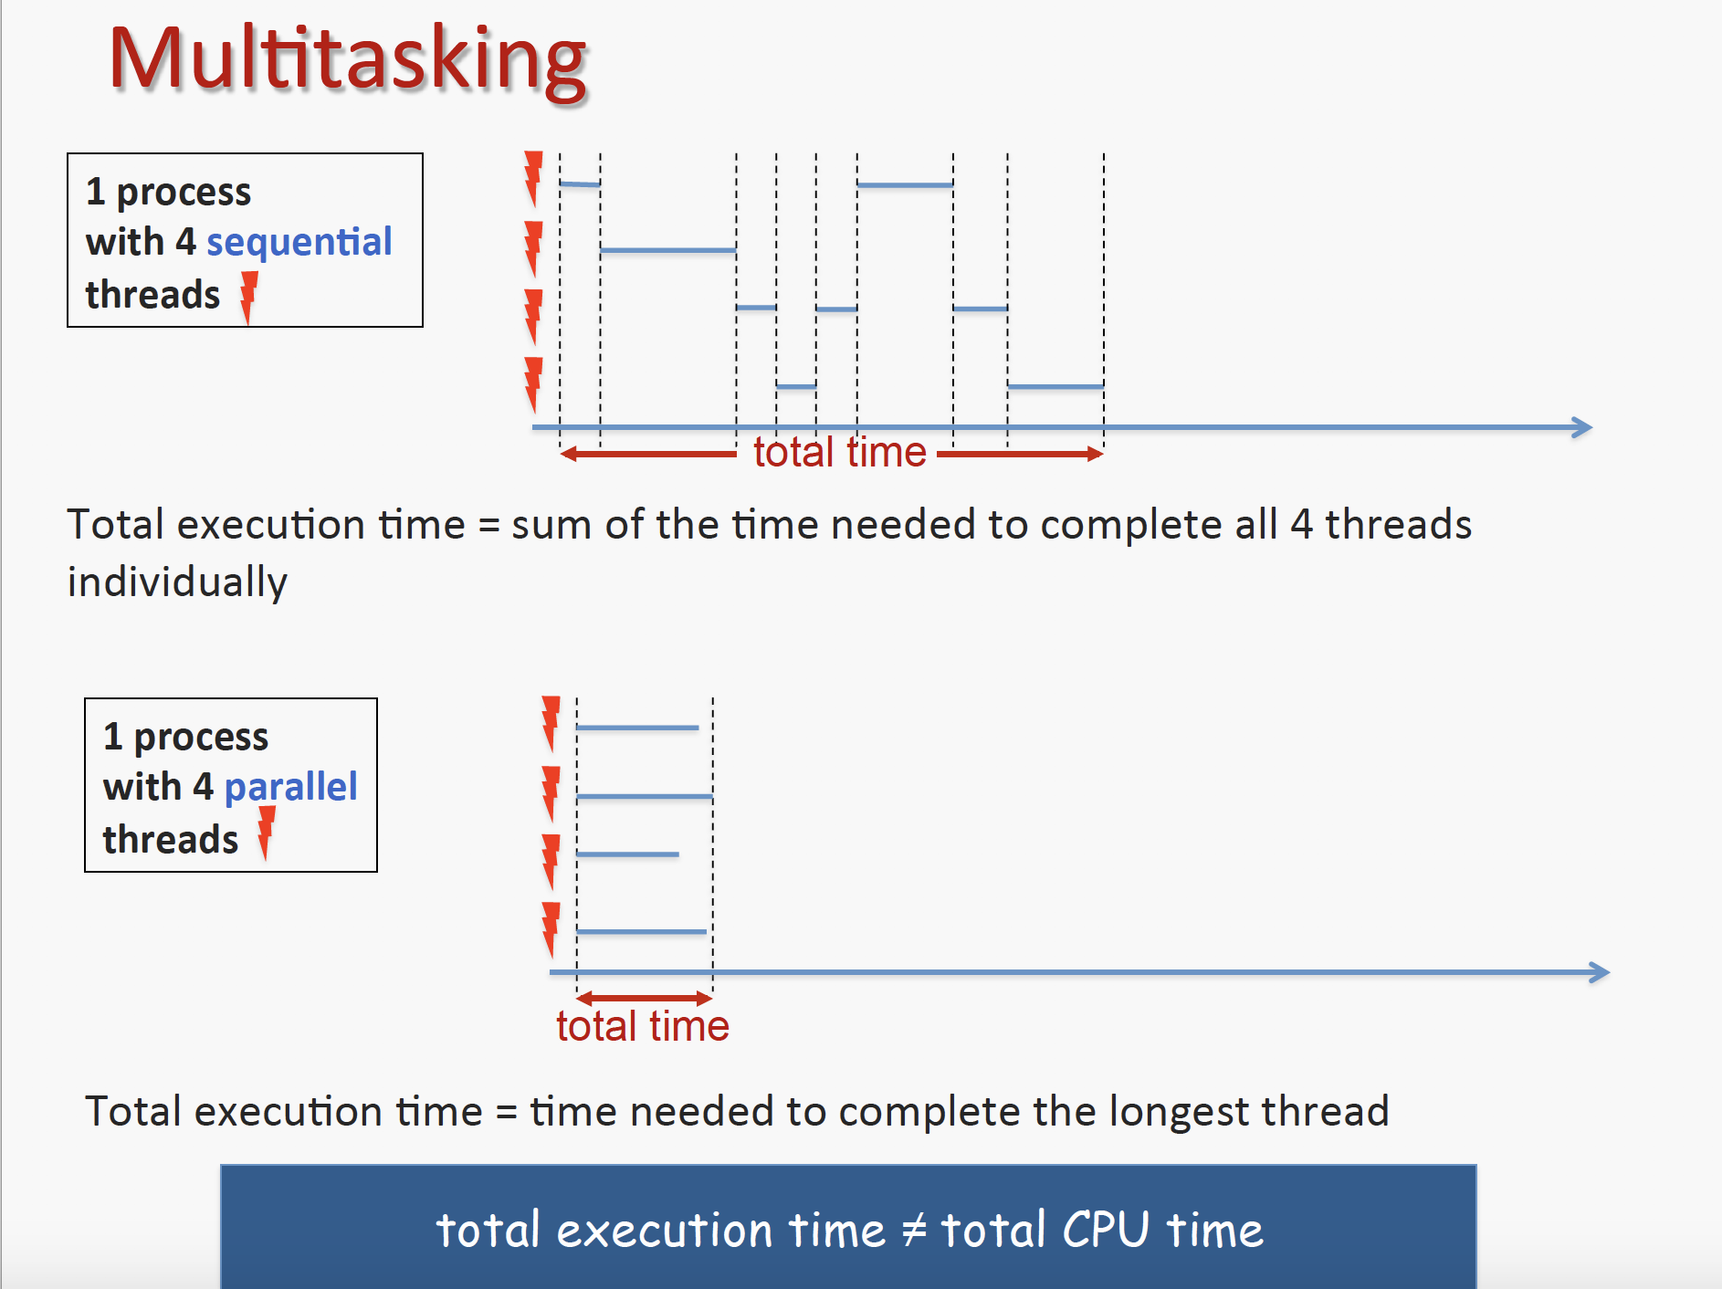

Slide 8
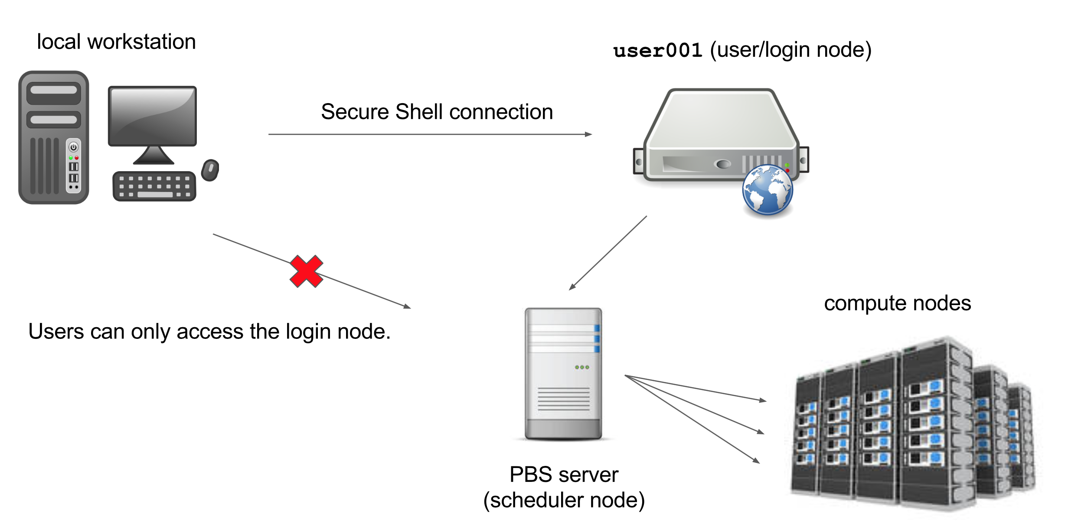
Where am I?
front-end
mac/linux: ssh
Windows: putty
Slurm
Each node/host is a computer

Slide 9
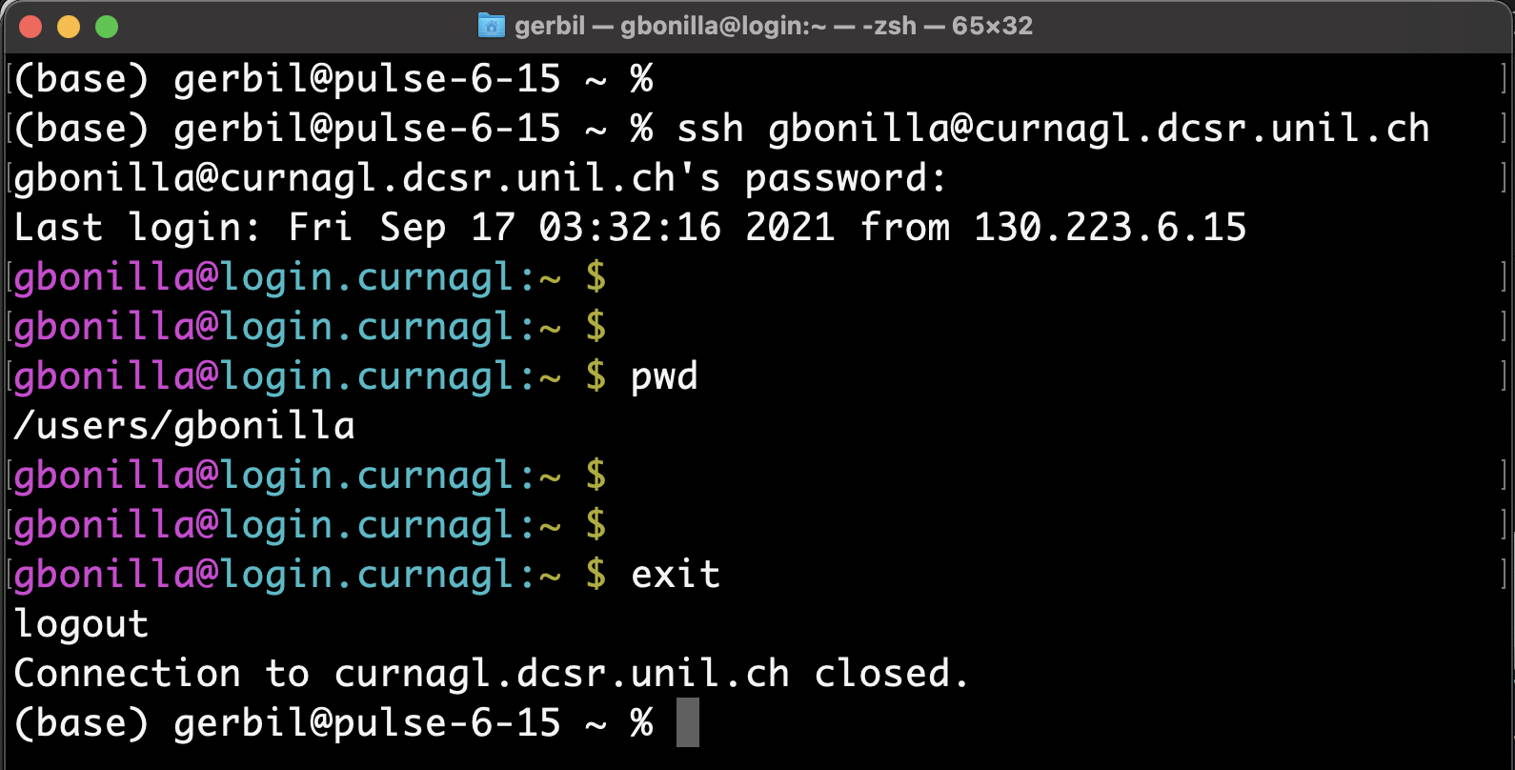
type this to log into the cluster
type this to know where you are on the filesystem
type this to log out of the cluster
You can always know what computer you’re logged into by looking here

Slide 10
Logging into the cluster
Linux/ OS X:
Open terminal
Type ssh <username>@curnagl.dcsr.unil.ch
Enter UNIL password
Windows:
Install Putty or Ubuntu bash (windows 10)
Hostname: curnagl.dcsr.unil.ch
UNIL username and password
When you type your password, it will be invisible. This is normal and for security!

Slide 11
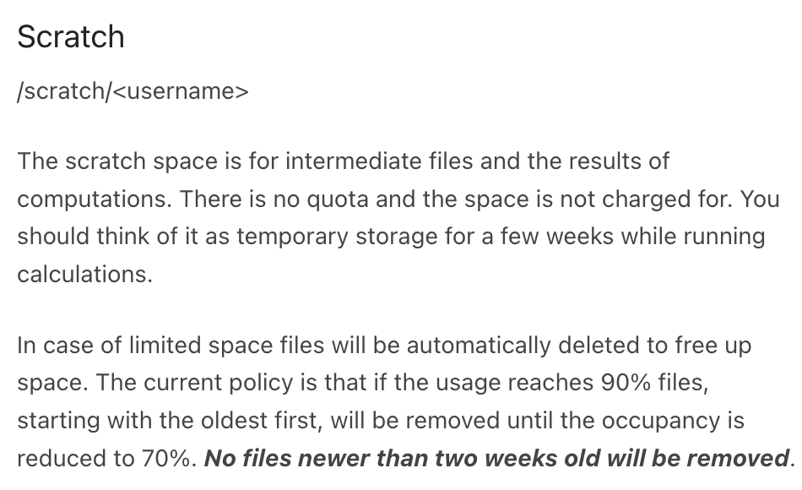
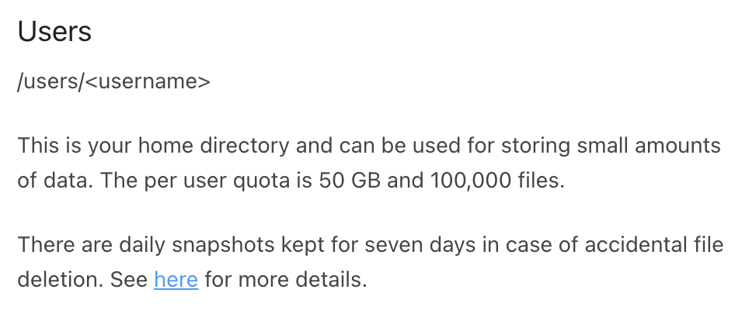
Where should you work?
https://wiki.unil.ch/ci/books/high-performance-computing-hpc/page/storage-on-curnagl
We have our own SAGE home at:
/scratch/jgianott/SAGE/SAGE2022_2023

Slide 12
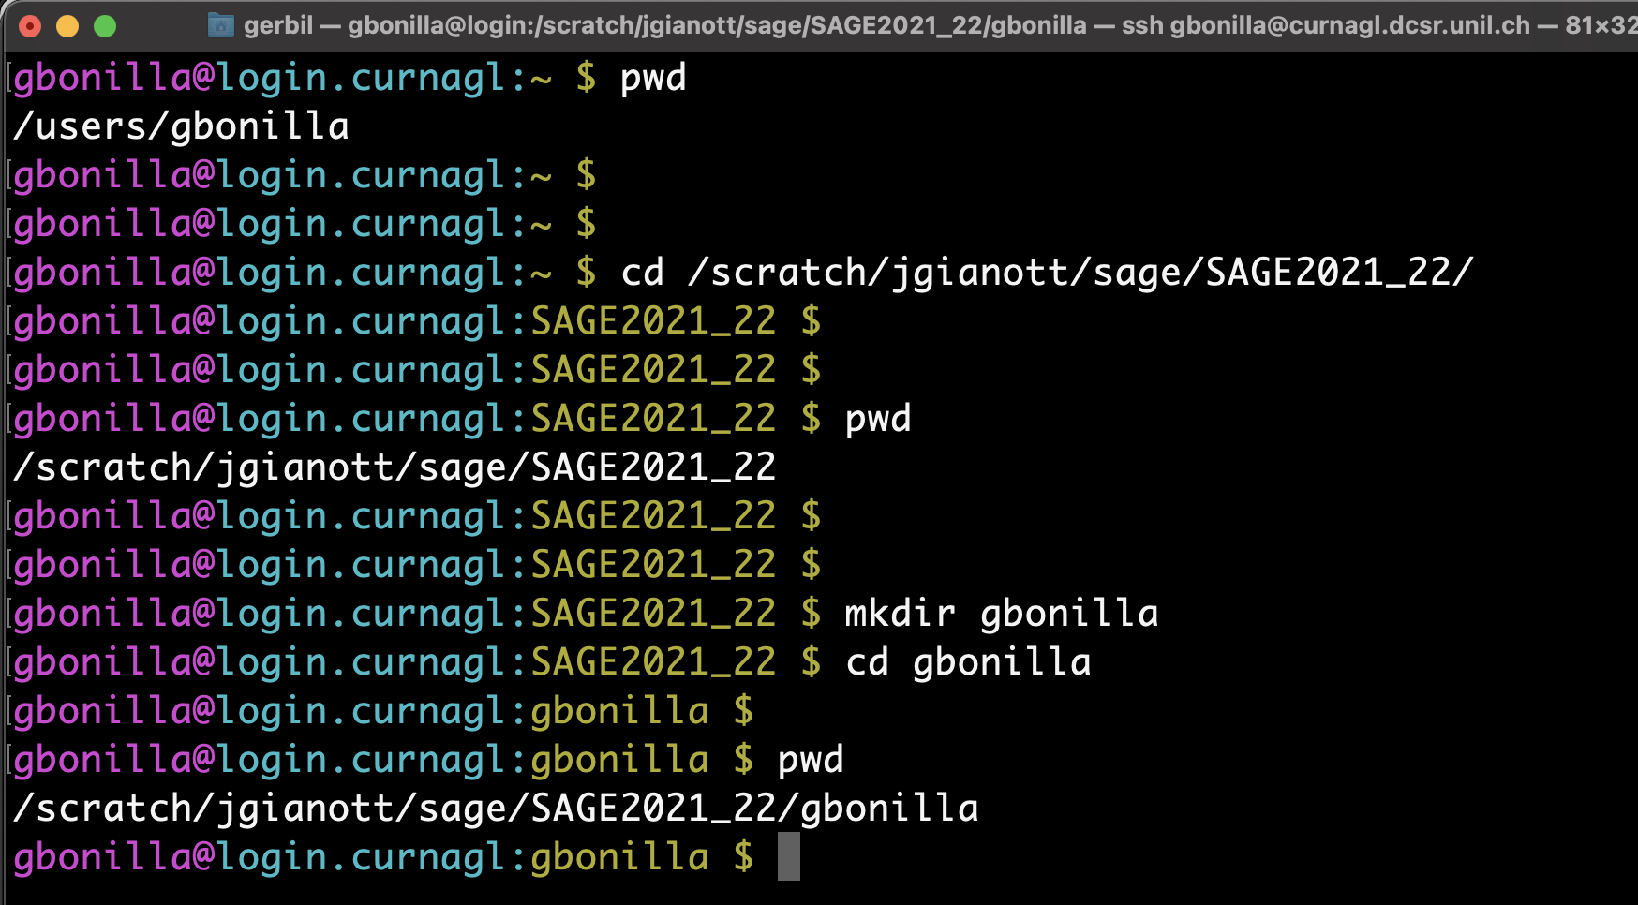
this “~” means you’re in your home directory on the cluster
Many people logged on to 1 computer sharing memory
Not a lot of storage space
System administrator will get mad
BUT, we don’t want to work here. WHY?
Work here instead
Lot’s of space
Fast saving
But erased every 2 weeks
Make a directory for you to work

Slide 13
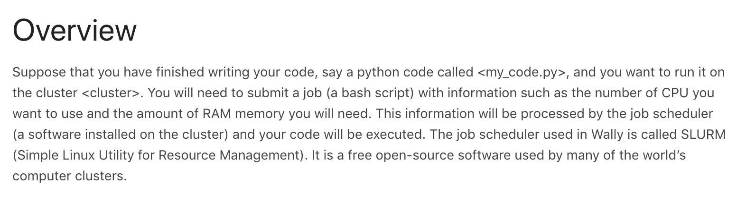
How to run a job on the cluster

Slide 14
Jobs
A job is one or several processes (a running program) grouped together as a single shell command
What you submit to the cluster, jobs get managed by Slurm (the scheduler) and directed to a particular host (computer in the cluster) for execution

Slide 15
Scripts
A text file that contains commands
Reproducible
Needed for submitting jobs to cluster
Usually have a .sh extension
Remember extensions in Linux are simply part of the filename !!!

Slide 16
How to write a script
All bash scripts should start with a line that specifies a language used for intepretation (shebang)
#!/bin/bash
Open a new file with a text editor
Then write all your commands, one per line or separated by ”;”
Save your script as a .sh file
Execute script by running:
bash <my_script>.sh
Don’t execute complicated scripts on the FrontEnd / LoginNode !!!

Slide 17
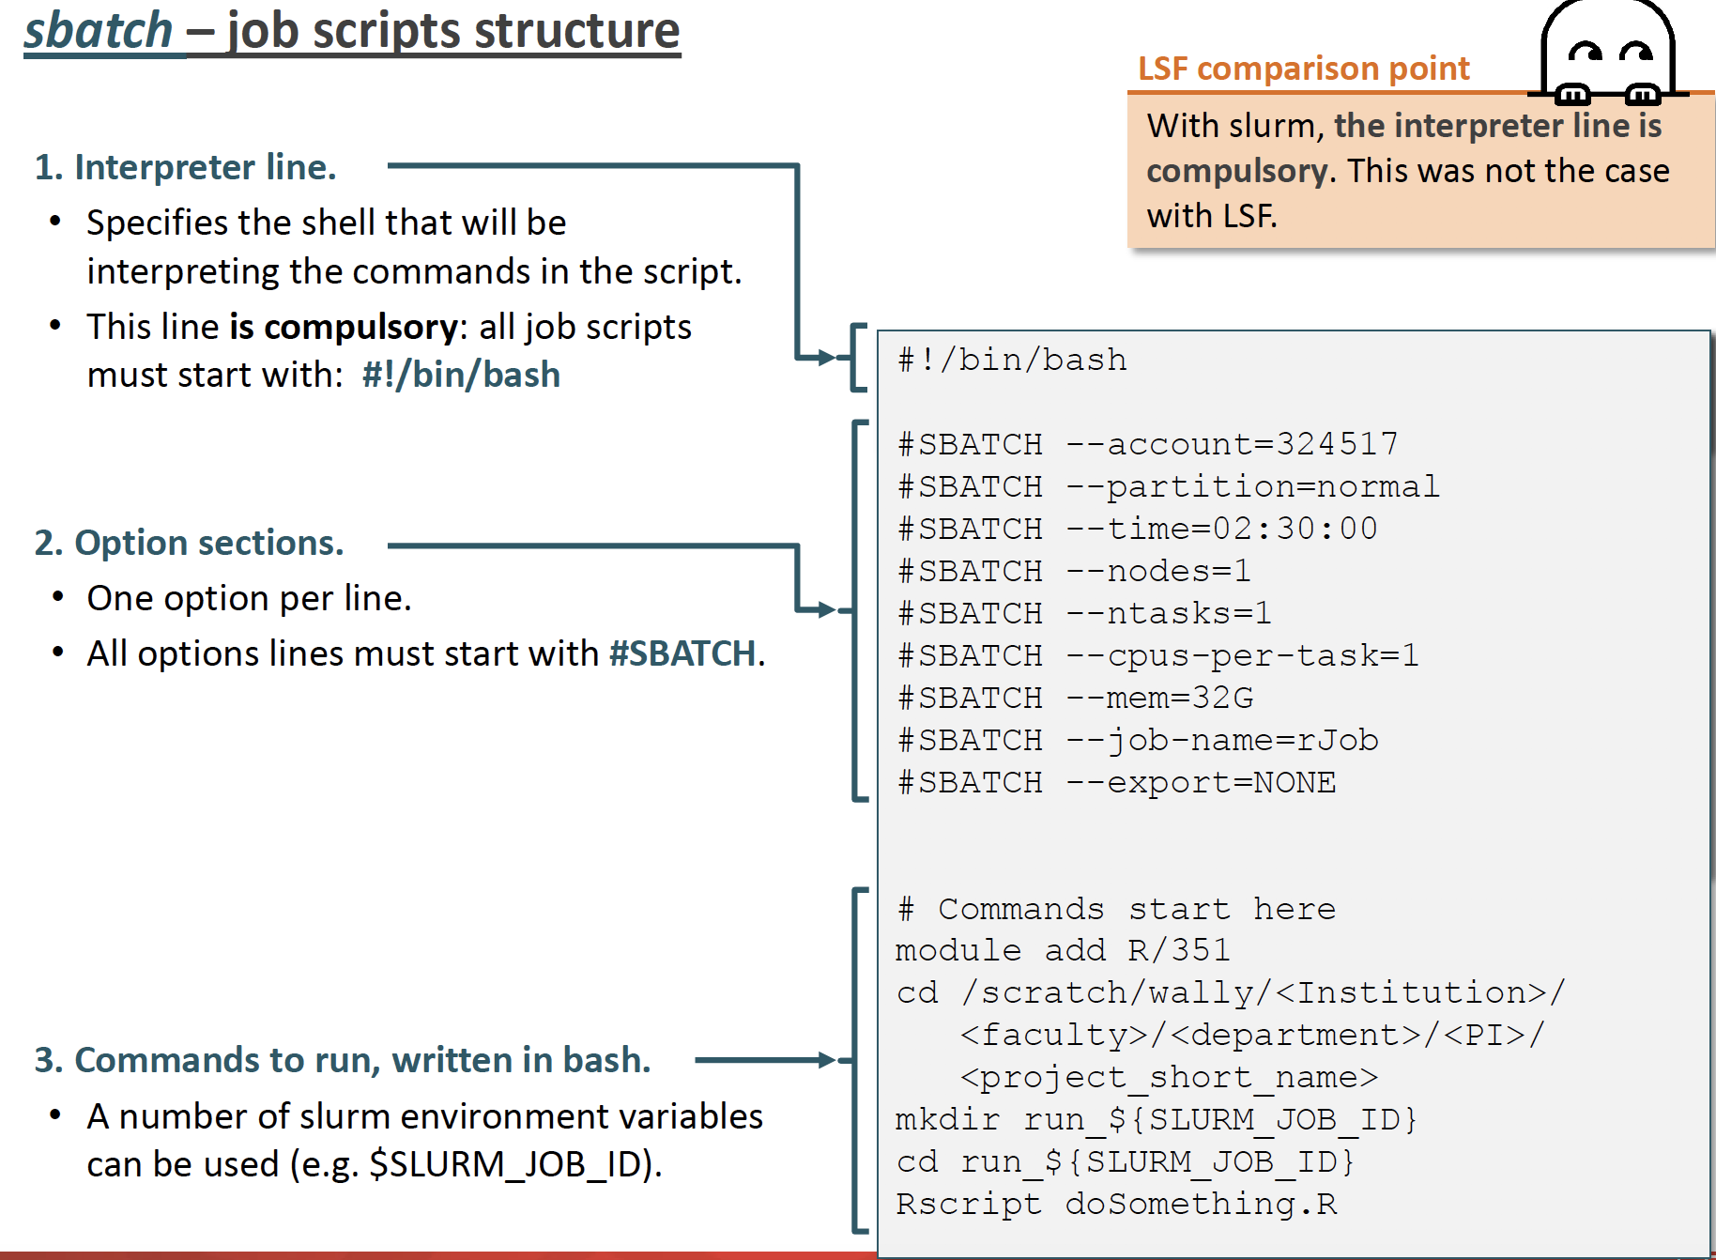
cpu

Slide 18
Example sbatch (job) script
#!/bin/bash
#SBATCH --partition=cpu
#SBATCH --account=jgianott_sage
#SBATCH --job-name= <job name>
#SBATCH --output= <full path to save std out>
#SBATCH –error= <full path to save std error>
#SBATCH --nodes= <number of requested nodes>
#SBATCH --ntasks= <number of tasks to run simultaneously>
#SBATCH --cpus-per-task= <CPUs request, 24 per node>
#SBATCH --mem= <memory request in MB or GB, max 512Gb>
#SBATCH --time= <hh:mm:ss>
#Type your commands below to execute on a host ↓ ↓ ↓ ↓

Slide 19
Example sbatch (job) script
#!/bin/bash
#SBATCH --partition=cpu
#SBATCH --account=jgianott_sage
#SBATCH --job-name= myFirstJob.sh
#SBATCH --output= /scratch/jgianott/sage/SAGE2022_23/<username>/logs/log_QC.out
#SBATCH –error= /scratch/jgianott/sage/SAGE2022_23/<username>/logs/log_QC.out
#SBATCH --nodes= 1
#SBATCH --ntasks= 1
#SBATCH --cpus-per-task= 1
#SBATCH --mem= 10MB
#SBATCH --time= 00:05:00
#Type your commands below to execute on a host ↓ ↓ ↓ ↓

Slide 20
The partitions
The cluster contains several partitions (set of nodes dedicated to different means).
In curnagl, there are three partitions:
cpu – This is the main/default partition. It is configured to prevent any single job from using all available resources, and to start mulit-node jobs with a reasonable delay. Normal jobs can run for 3 days, short jobs can run for 12 hrs, and both can use up to 2/3 of the resources.
gpu – This partition gathers all GPU nodes. Normal jobs can run for 1 day, short jobs can run for 6 hrs, and both can use up to 2/3 of the resources.
interactive – this partition gives you access to resources for interactive software, but you can only use 1 job at a time, and run a job for a maximum of 8 hrs.
Each partition is associated with a submission queue (waiting line for jobs matching availableand requested resources).

Slide 21
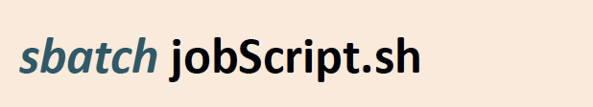
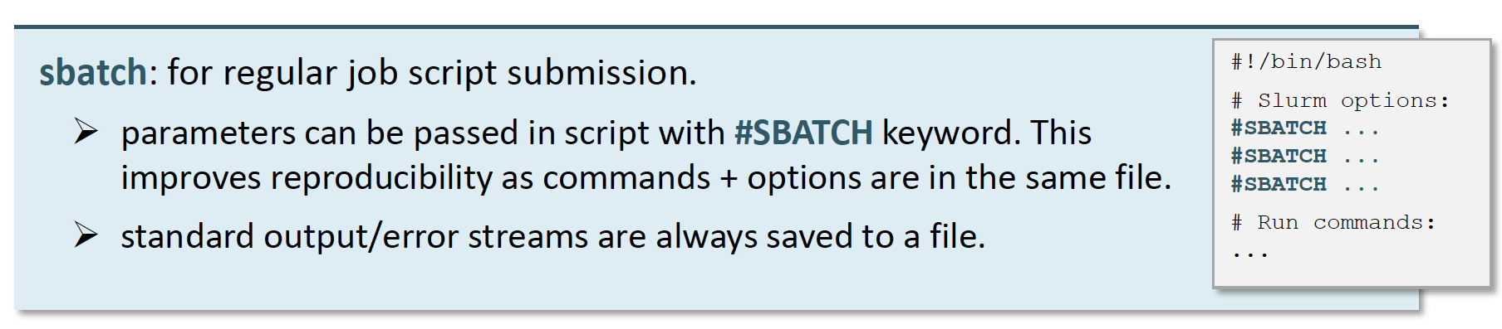

How to submit a job
Here, we will only do single node jobs using scripts, but array jobs exist too

Slide 22
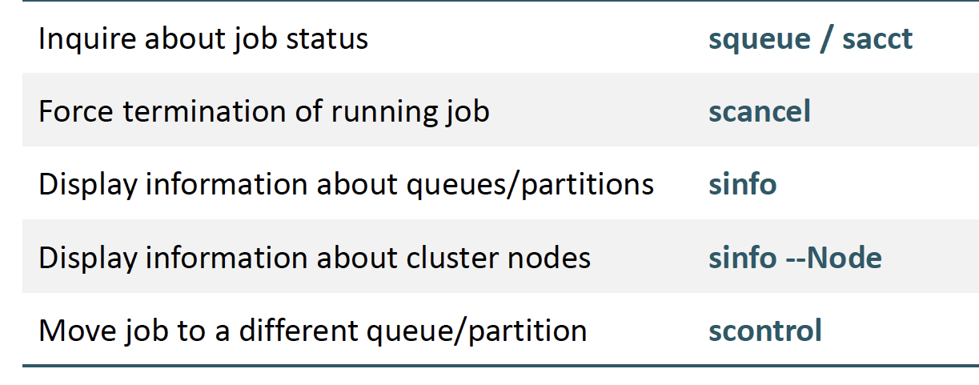
Slurm: other commands

Slide 23
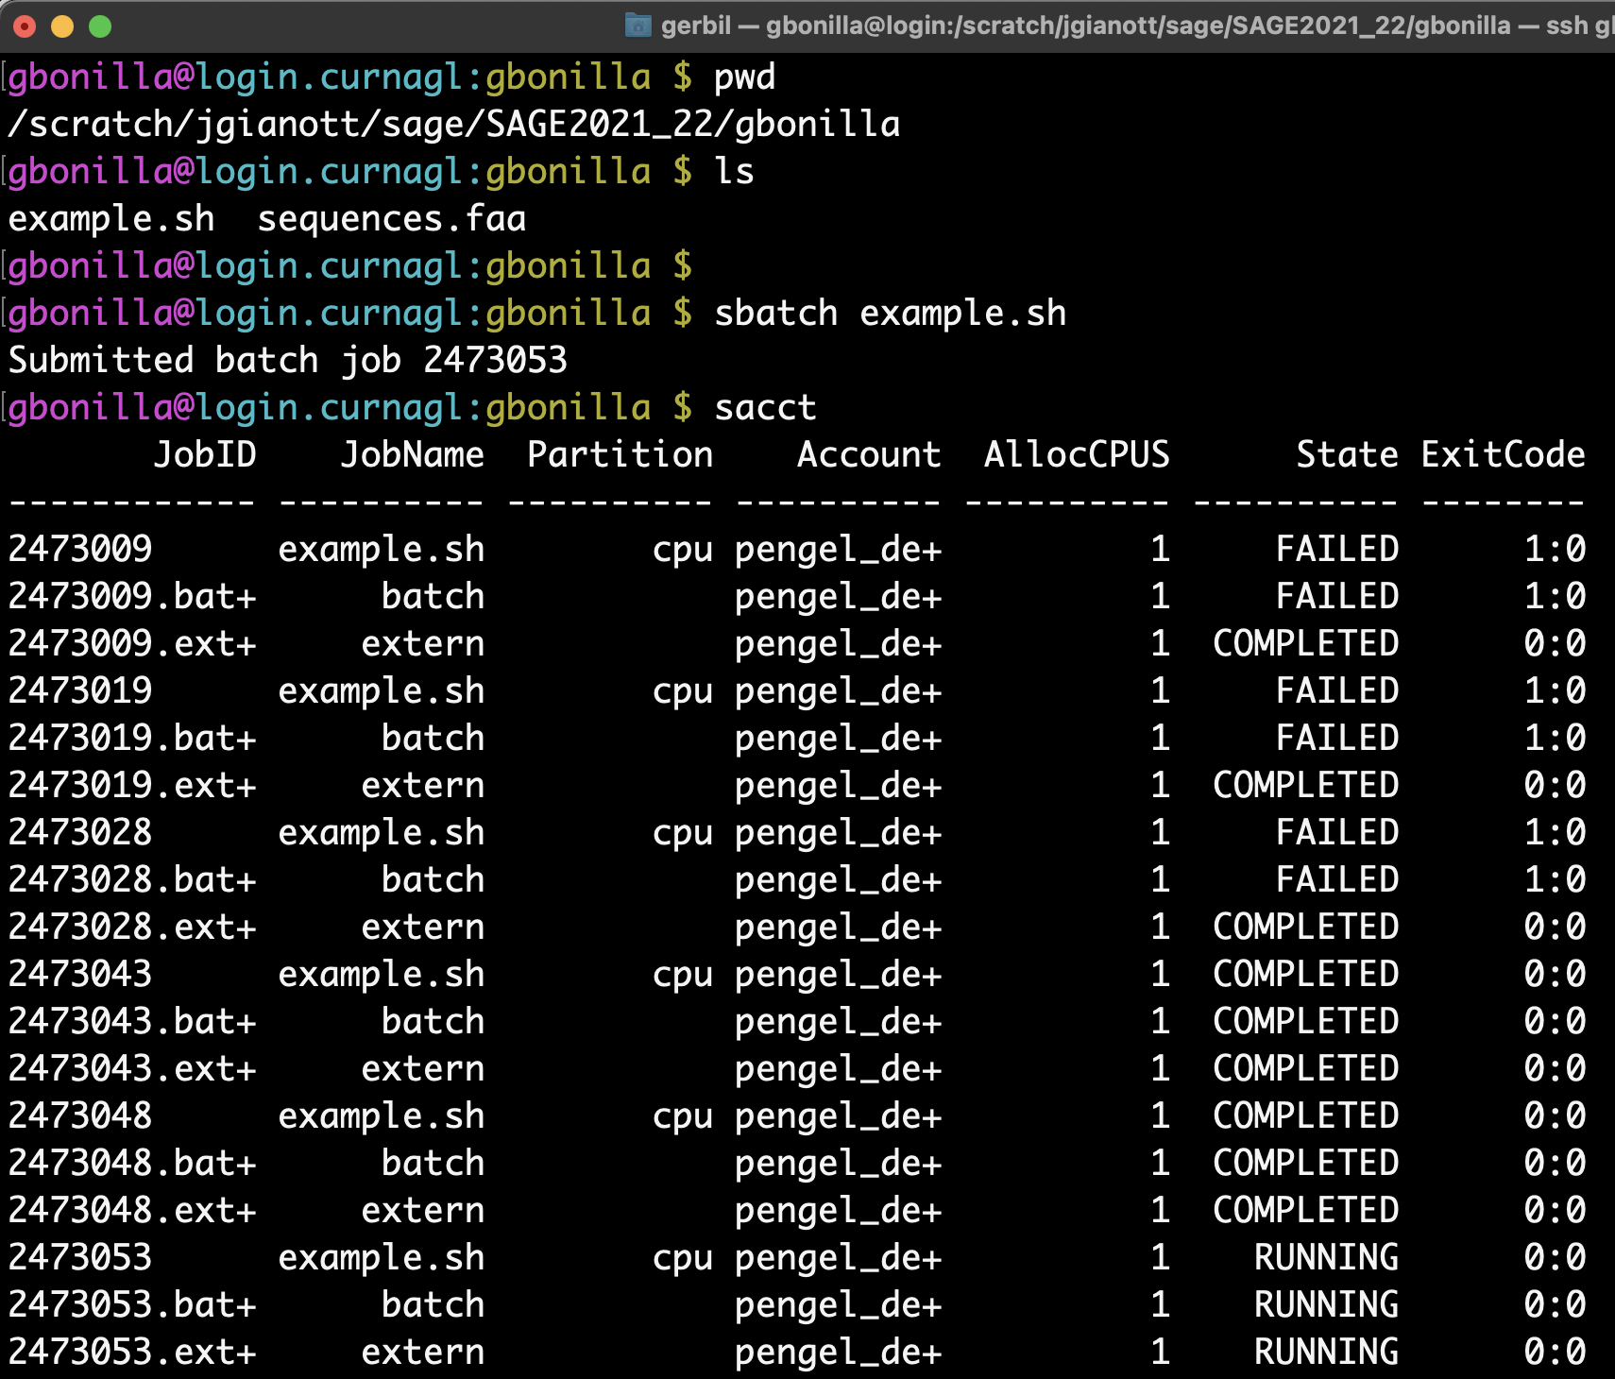
Check on the status of a job

Slide 24
Running software on the cluster
Many software are already installed on the cluster– you don’t have to worry about downloading and installing them, you just need to execute them
Try to run mafft (a software for making multiple sequence alignments) on the cluster by typing mafft into the command line

Slide 25
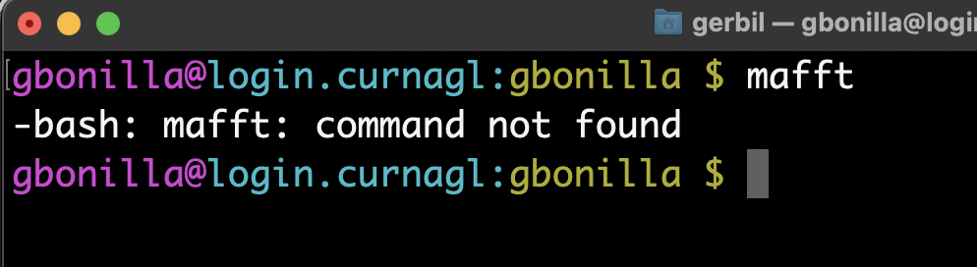
Running software
Why doesn’t this work??

Slide 26
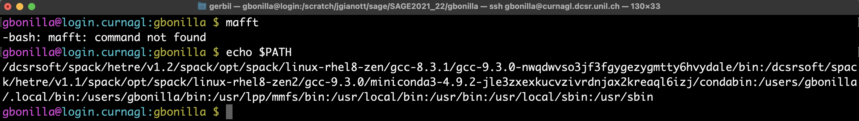
Running software
It doesn’t work because the computer searches for the software binary in a predefined set of directories.
You can find out which directories it will search for the software in by typing echo $PATH
The computer will search through all these directories (separated by a “:”) to look for the software you specified
However, these are all “personal” directories, so it is not where mafft is installed (software for everyone to use)

Slide 27
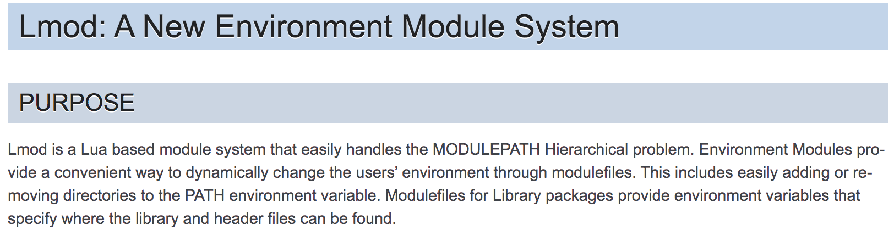
Finding software on the cluster

Slide 28
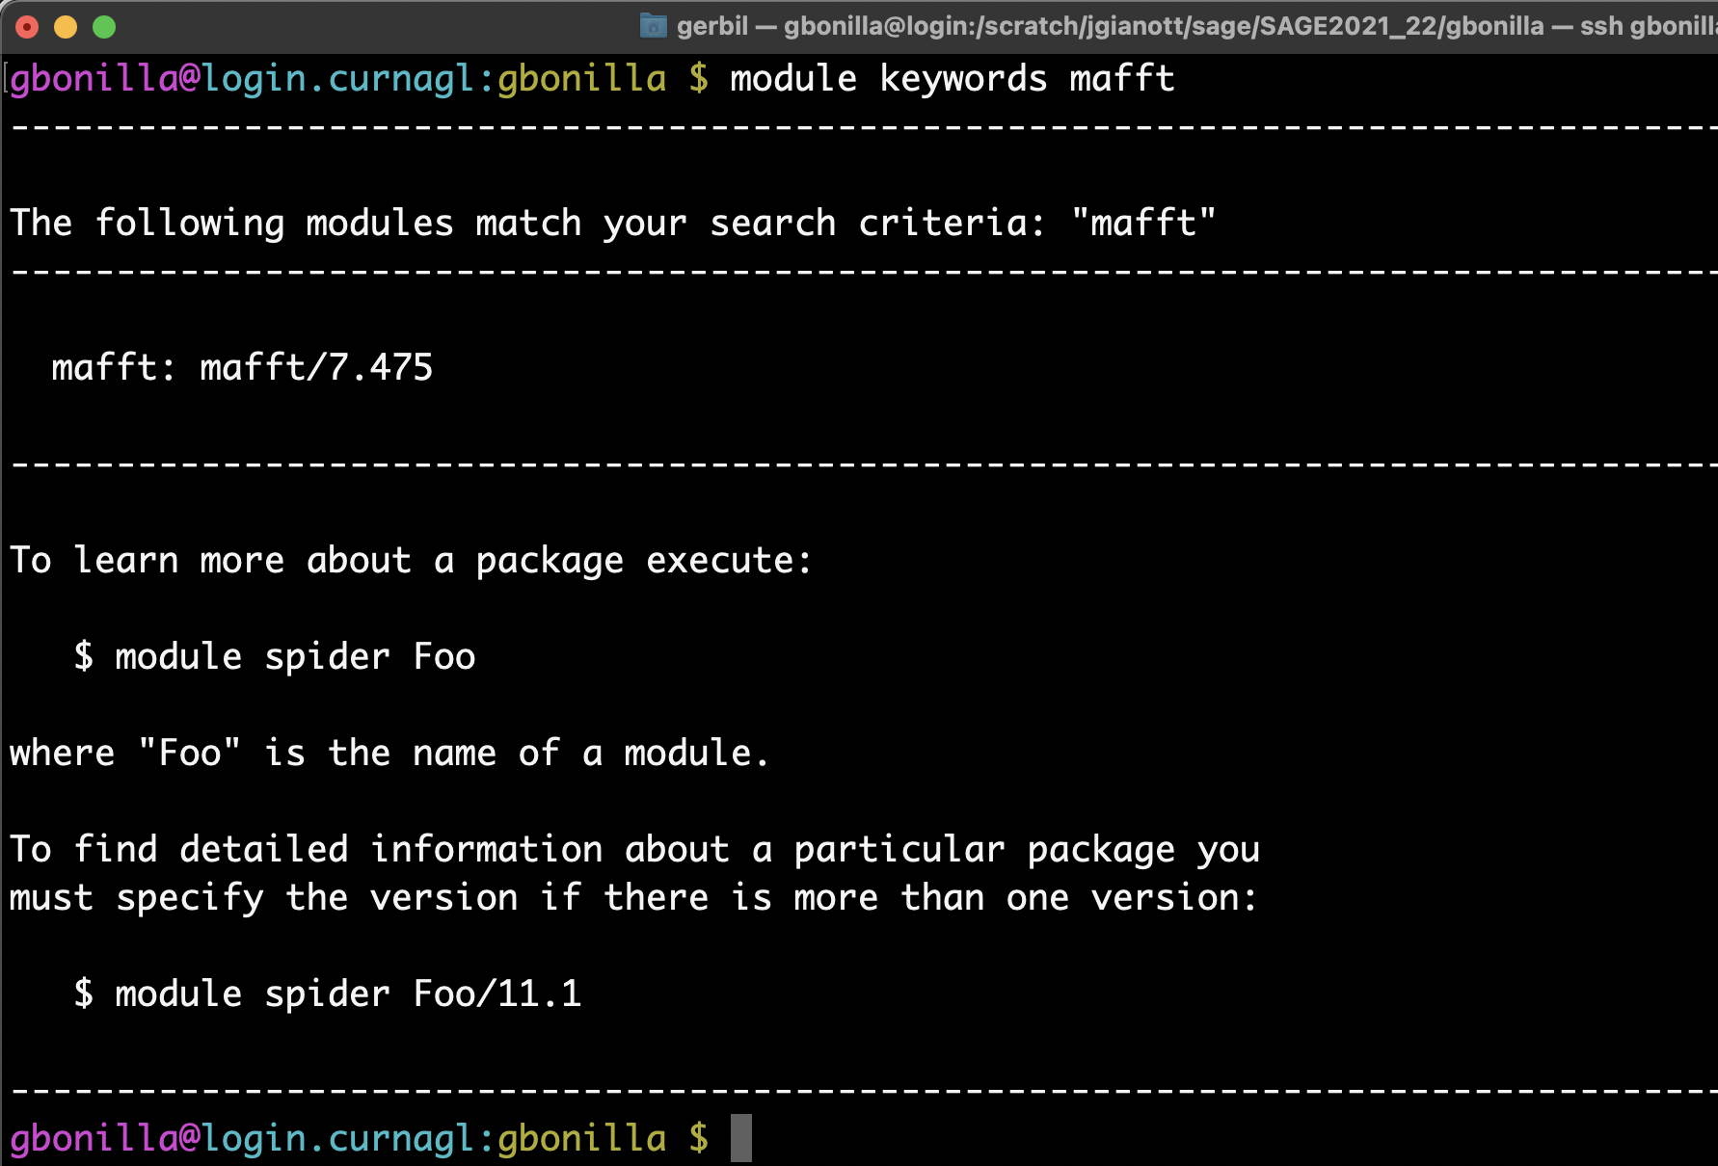
Finding software on the cluster
Second, search for your software by module keywords <name of software>

Slide 29
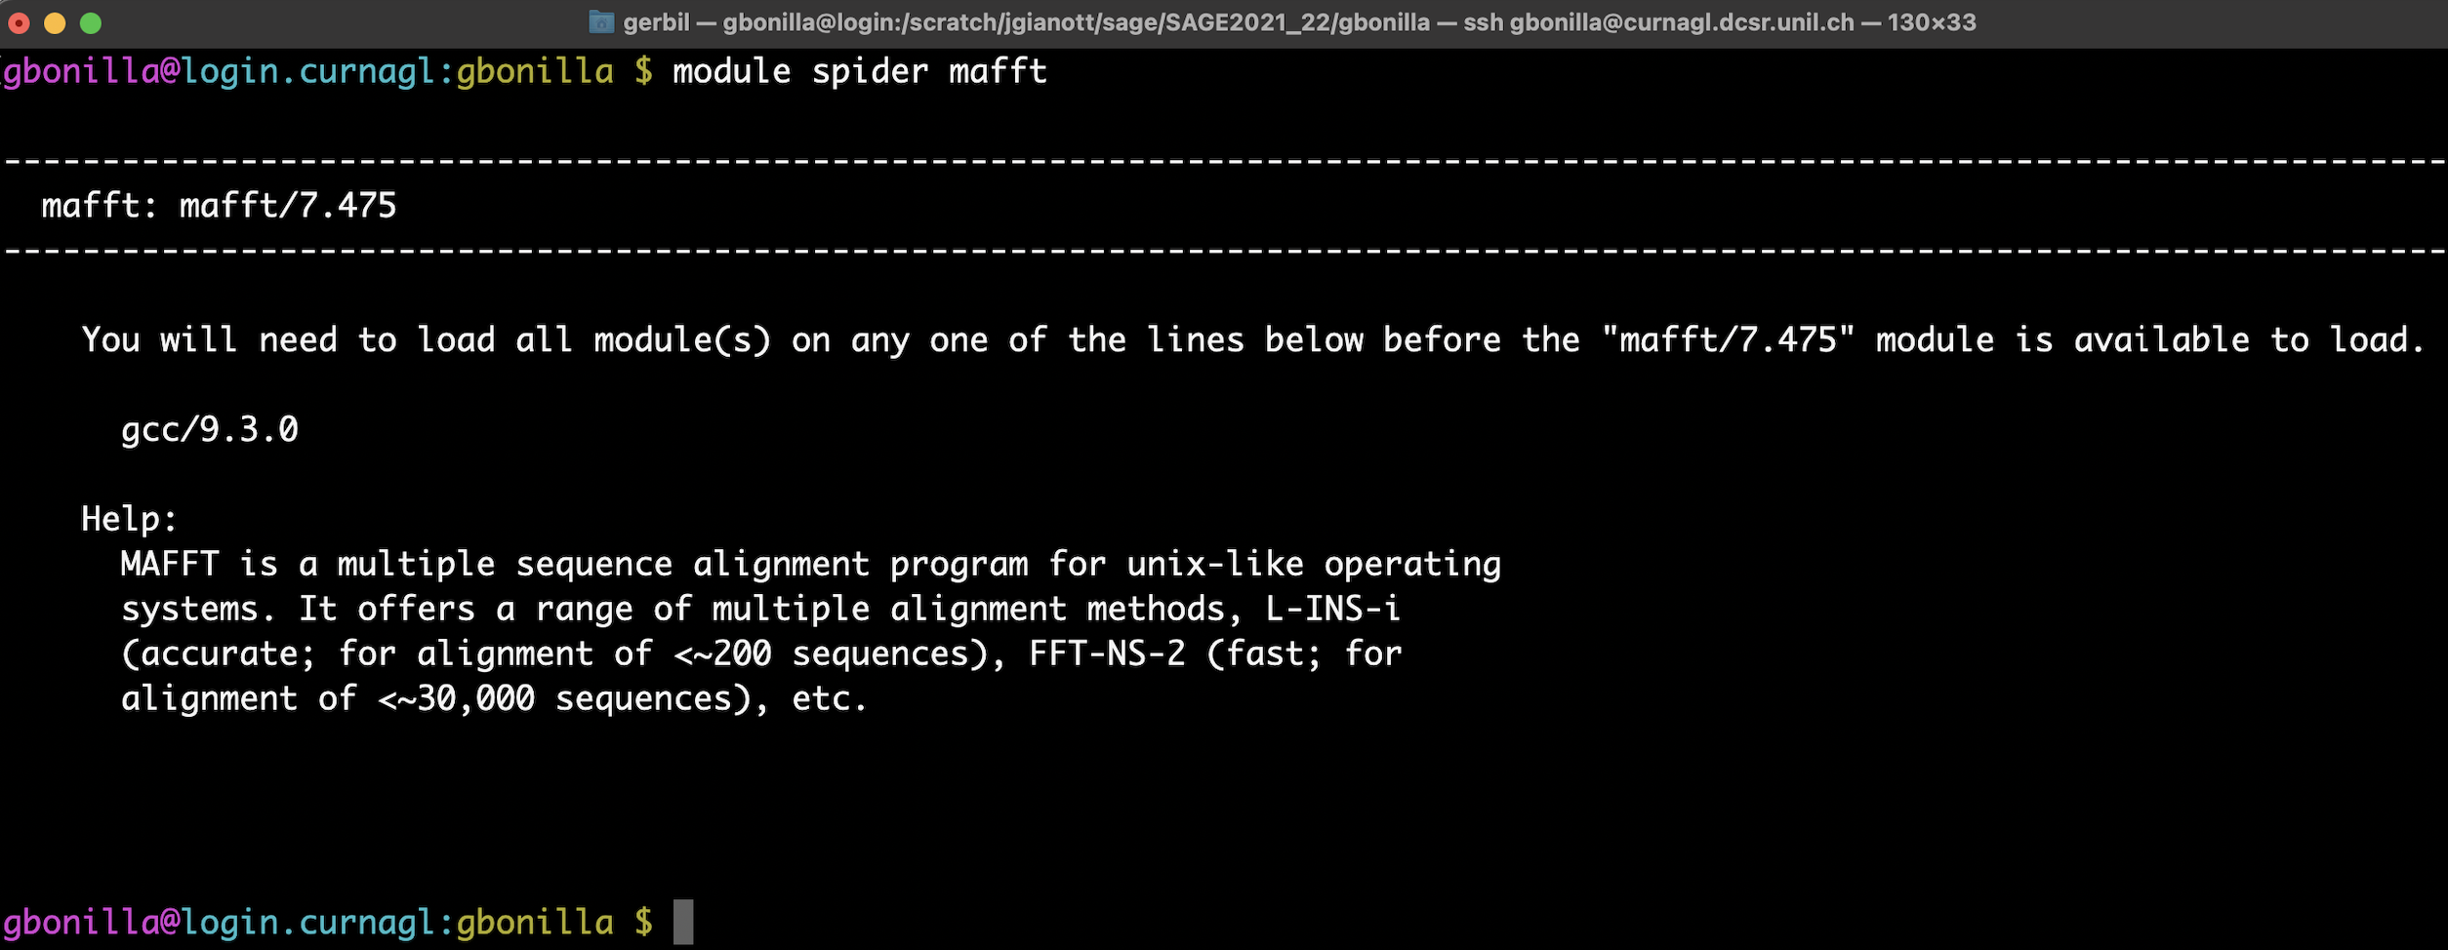
Finding software on the cluster
Third, figure out which dependencies you need to load, with module spider <program>

Slide 30
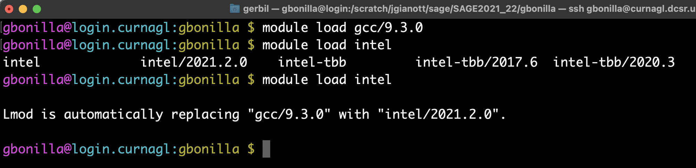
Some modules are replaced when redundant… so better load/unload wisely!

Slide 31
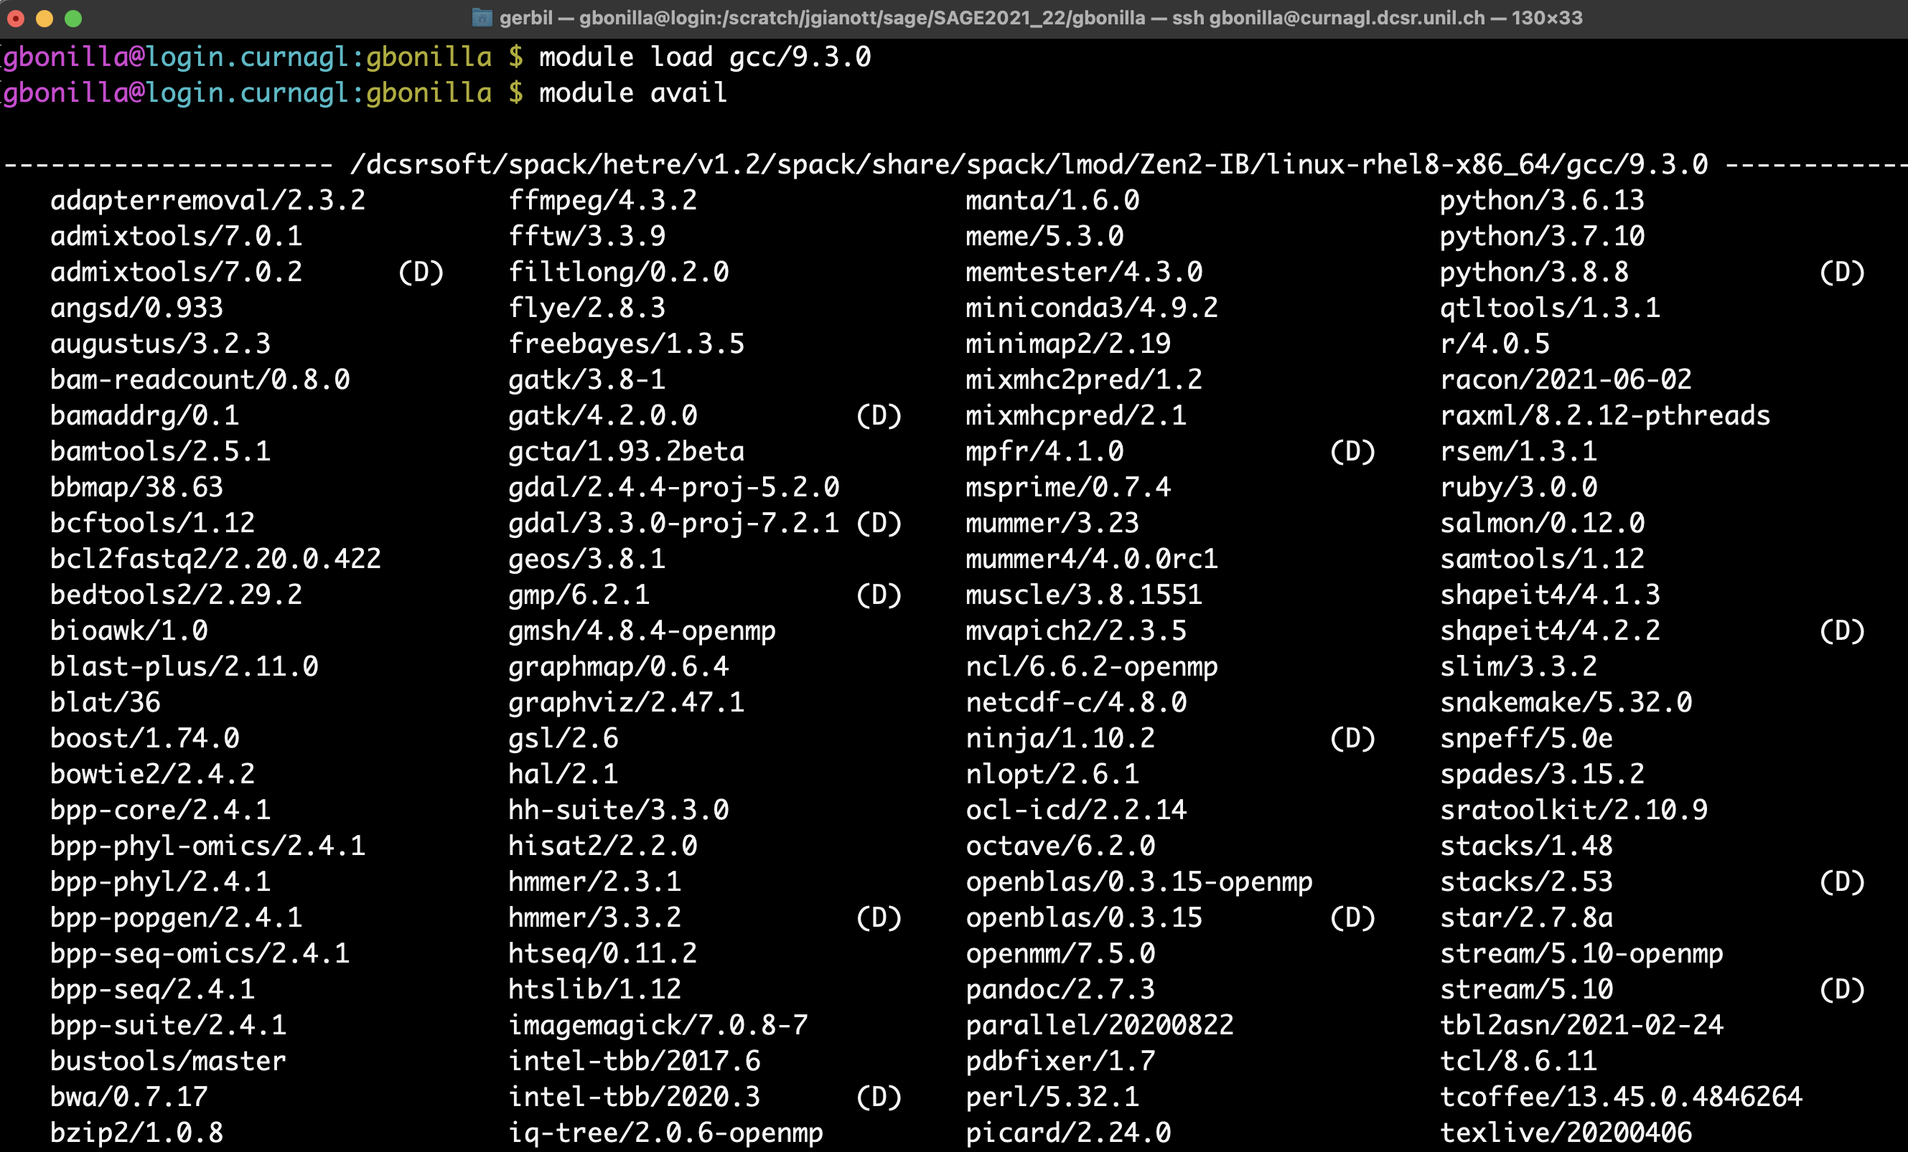

Slide 32
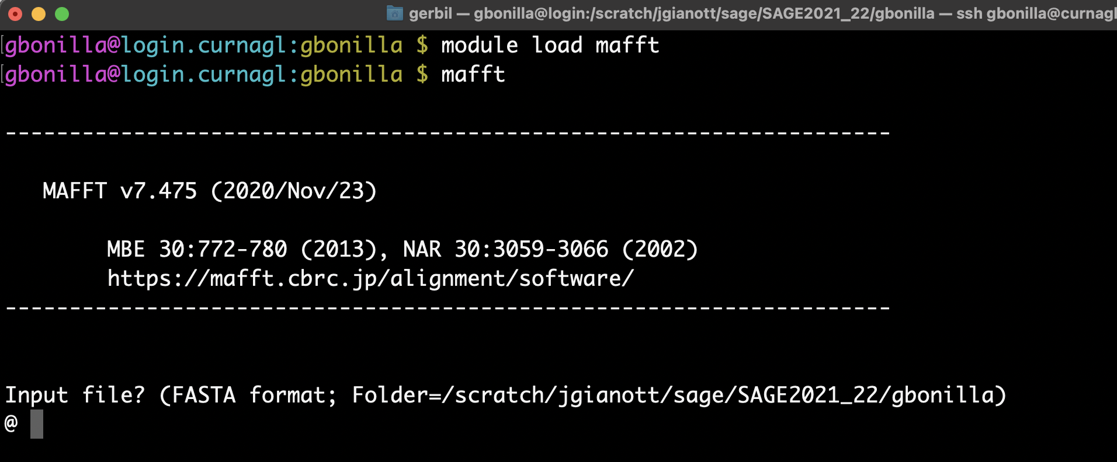
Now mafft works!
(And don’t forget you can use tab autocomplete)

Slide 33

Stop here and complete tutorial #1 (Making a job script) & #2 (Running a job script)

